Slide 1








Originators
PRESENTATION-1

Slide 2
GROUP MEMBERS
Nafrin Kabir Tropa- 011213119
Jannatul Tajrian- 011221483
Kaniz Fatema- 011202234
Mohammad Rakibul Asib-011221177

Slide 3


System
a system refers to a collection of interconnected components that work together to perform a specific function or set of functions

Slide 4



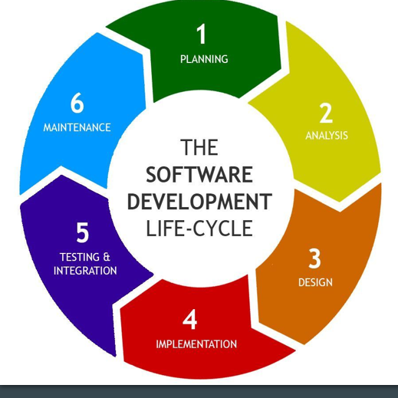


SDLC
A process used by the software industry to design, develop and test high quality softwares.
SDLC Steps

Slide 5



SDLC STEPS
1
4
PLANNING
IMPLEMENTATION
2
5
ANALYSIS
TESTING & INTEGRATION
3
6
DESIGN
MAINTAINENCE

Slide 6

Project idea
UIU COUNSELLING
We want to create a website where, we will provide to communicate the faculty easily . Faculty will give counselling hour for students and then students will solve their problems. Also we will handling time consumption.
UIU COUNSELLING

Slide 7




Actors of our project
Student
Faculty
Admin

Slide 8
Use Case
1
3
USER MANAGEMENT
COUNSELLING
2
4
COURSE MANAGEMENT
TOTAL PARTICIPATION

Slide 9


Information Gathering
Internal Sources
External Sources
➔ Onsite Observation
➔ Online Articles
➔ Benchmark products

Slide 10

Benchmark Analysis

Slide 11

Product-1
Virtual Class
Course Enroll
No scheduling Counselling time

Slide 12

Product-2
Talk to expert
Project verification

Slide 13

Product-3
Digital Library
Course enroll
Talk to expert

Slide 14

Product-4
Course Enroll

Slide 15
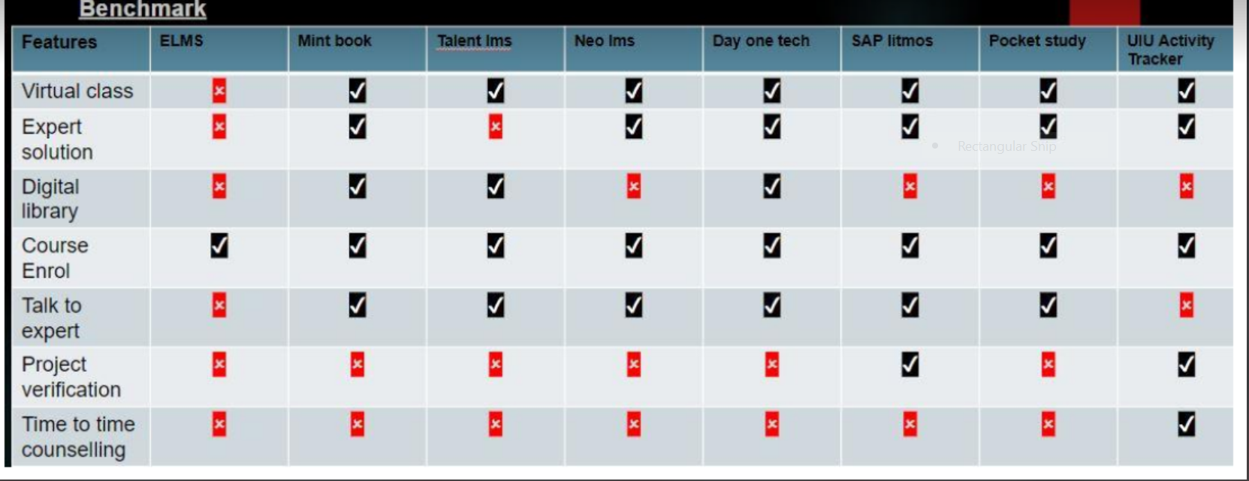
Comparison

Slide 16



Gap Analysis
Time to Time Counselling

Slide 17
Feature List Fixstion
Functional
Non-functional
Time to Time Counselling
Student Profile
Faculty Profile
Operational Requirement
Performance Req
Cultural Req

Slide 18


Thanks!
www.reallygreatsite.com

